Slide 1


Slide 2
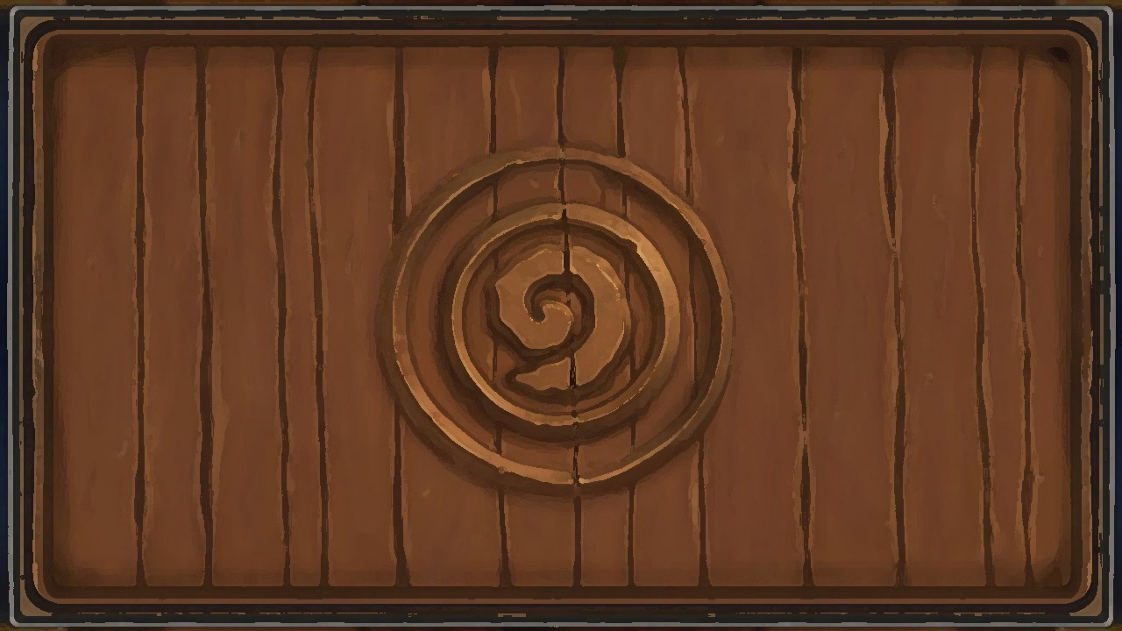
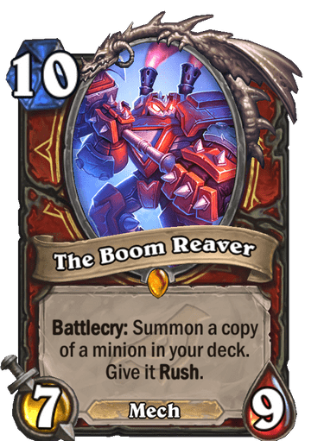
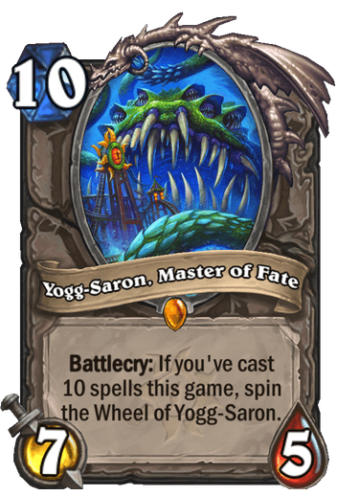
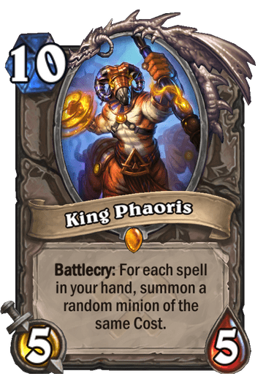
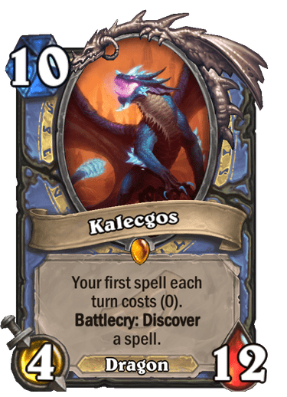
PLAYERS
Kevin Pulley
Jonathan Stillman
Billy Arrasmith
Kate Hile

Slide 3
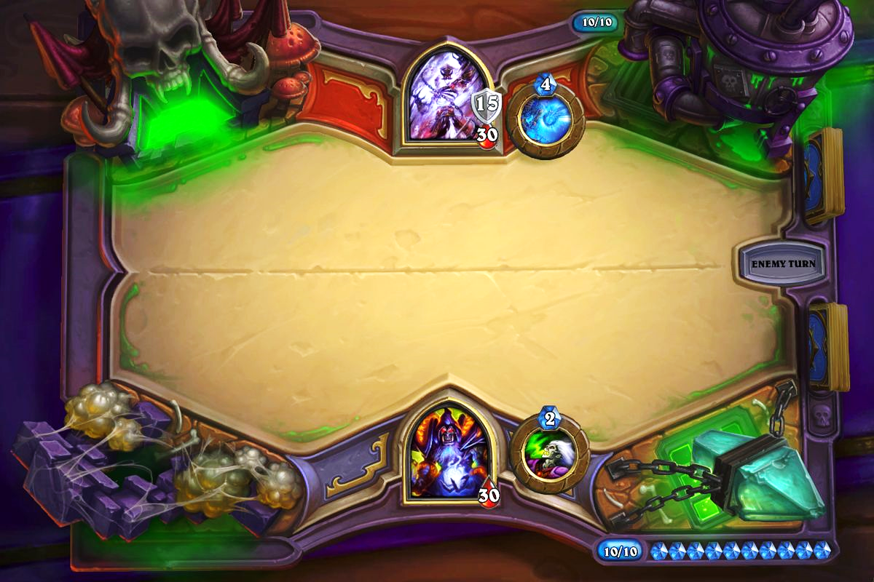
Overview
The motivation for the development of this app was creating a source, Hearthstone card players could access to gain knowledge of the cards and build a personalized deck. Providing access to over 500 cards, 10 classes with the option to search by both. Functions of the app include, card search, class search, card specifics and local repository. A deck is included so the user can save their selected card options.

Slide 4
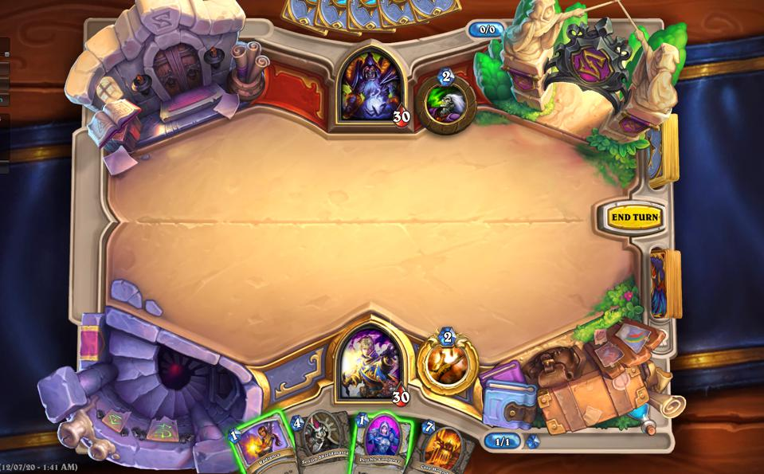
Process
The tech used included the Hearthstone API, MySQL, JQuery, HTML, CSS,JS,Express,Node,Handlebars,Heroku,and Toastr. Billy and Kevin worked on the backend design as Jonathan and Kate worked on front end. Everyone worked on edits and updates for the entire app.

Slide 5
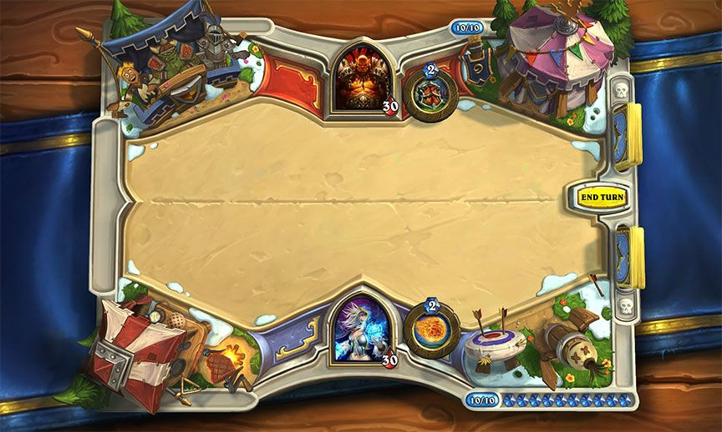
But, why?
This app is solving the user’s need of being able to view individual cards, groups in classes and then saving to their personalized deck. We built the app to be user friendly and does not require a subscription. This interface will appeal to the newbie players and the experienced alike with mirroring aesthetics, multi search functions and local repository capabilities.

Slide 6

Github Link
Heroku Link

